Slide 1
Decision Making

Slide 2
What is Decision-Making?
Almost any cognitive function
encompassing
Flexibility
Contingency
Provisional Plan
Derived from Deliberation
Results in Commitment

Slide 3
An Extreme Example
Waking up
to a Baby Crying
but not to
Thunder
Traffic Noise…
Decision-Making
at an Unconscious Level??

Slide 4
Decision-Making Topics
Moral Philosophy
Neuroeconomics
Learning
Foraging
Reward
Lack of Reward
Perception and Motor Control
Stress…Anxiety…Depression

Slide 5
Social Decision-Making includes:
Individual Recognition
Status Recognition
Hierarchy
Reward/Validation
Punishment/Invalidation
Stress Vulnerability or Resilience

Slide 6
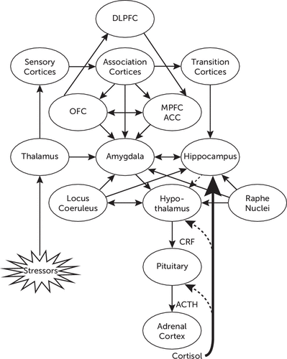
If Decision-Making includes Stress Vulnerability and Resilience
Neurocircuitry
Then…

Slide 7
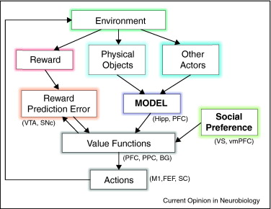
Components of Social Decision-Making
= Perceived Environment
Notes:
Components of social decision-making and their possible neural substrates. The environment of a decision maker provides three different types of information useful for decision-making. First, it delivers reward, and its deviation from the predicted reward (reward prediction error) modifies the value functions used to select actions. Second, information about various physical objects can be used to update the decision maker's model about his or her environment. Third, observed actions of other actors can be used to update the decision maker's model about their likely future behaviors. In addition, social preference of the decision makers can also influence their value functions. FEF, frontal eye field; Hipp, hippocampus; M1, primary motor cortex; PFC, prefrontal cortex; PPC, posterior parietal cortex; SC, superior colliculus; SNc, substantia nigra pars compacta; vmPFC, ventromedial prefrontal cortex; VS, ventral striatum; VTA, ventral tegmental area.

Slide 8
The Decision Stage
Perception
Deliberation
Choice
Action
Response Time

Slide 9
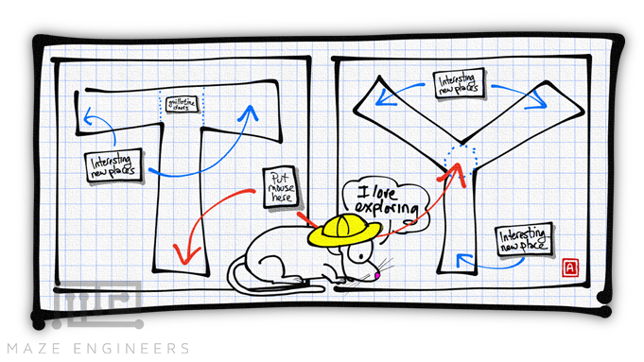
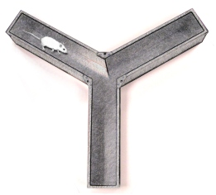
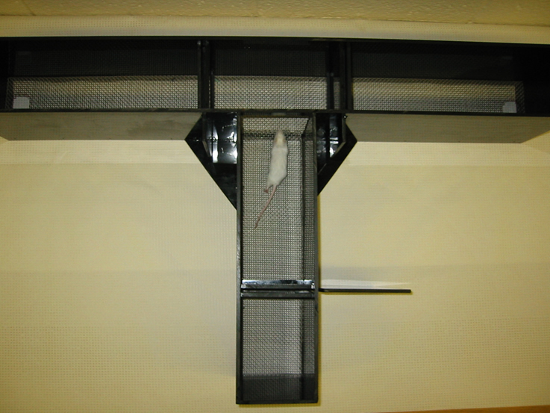
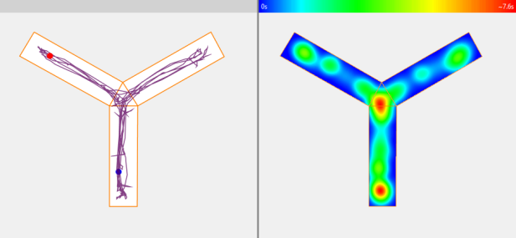
Simple Choice Tests: Y and T mazes
Simple

Slide 10
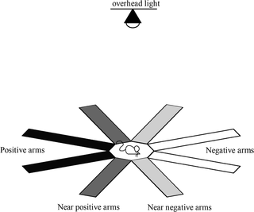
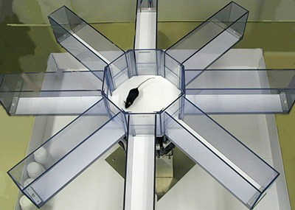
Radial Arm Maze
More Complex

Slide 11
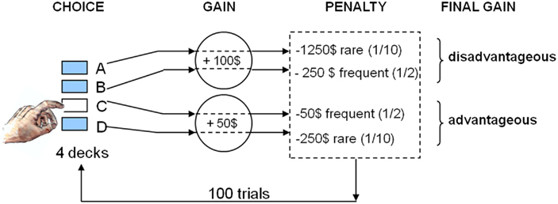
Iowa Gambling Test Choices based on Probability
Very Complex

Slide 12
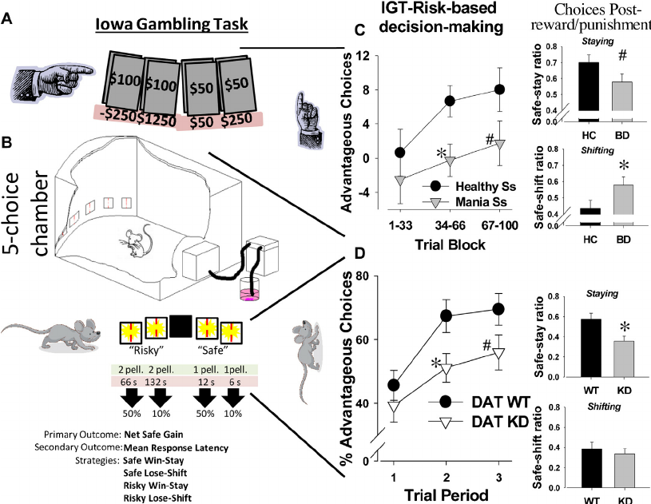
Rodent IGT

Slide 13
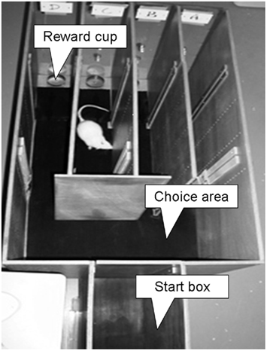
Rodent Iowa Gambling Test

Slide 14
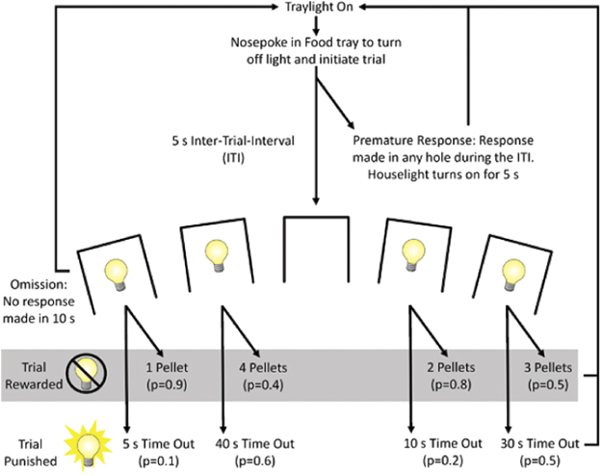
Rodent IGT

Slide 15
Does it Matter if the Task is Relevant?
What does it mean if you ask an animal to make a decision in a context that it would never naturally see?
i.e. Fits the Evolutionary and Ecological Contexts specific to the animal’s natural life?

Slide 16
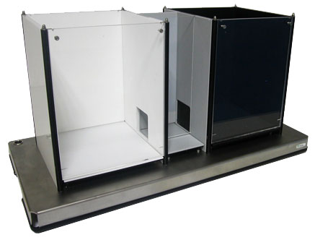
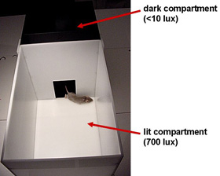
Light Dark Box
Salience

Slide 17
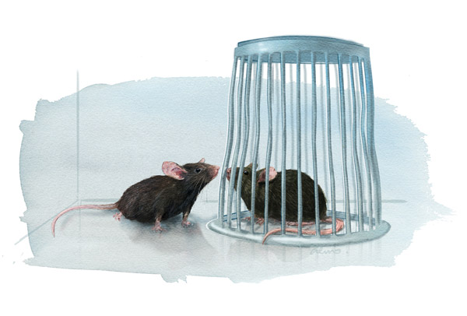
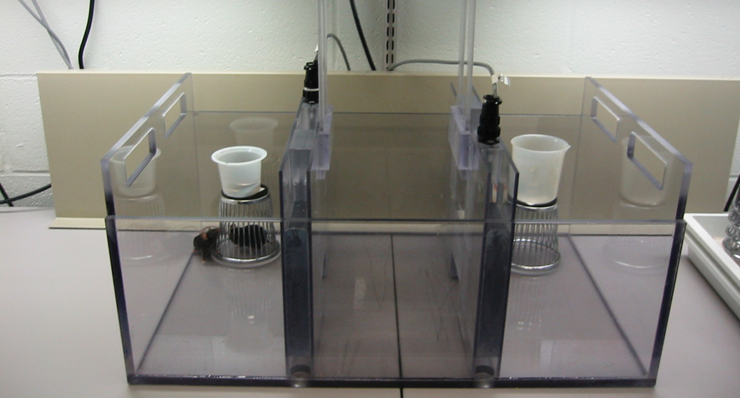
Social/Asocial Choice Test
Salience

Slide 18
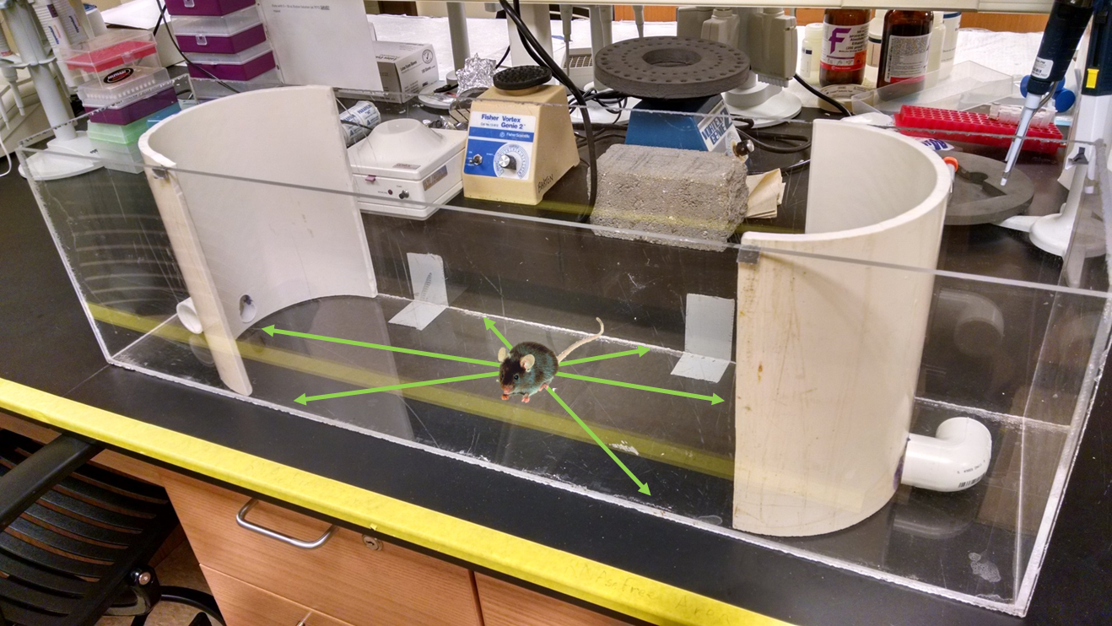
Stress-Alternatives Model
Salience
Escape
Stay
Escape

Slide 19
Decision-Making in Relation to Depression
≠
Depression
Notes:
Components of social decision-making and their possible neural substrates. The environment of a decision maker provides three different types of information useful for decision-making. First, it delivers reward, and its deviation from the predicted reward (reward prediction error) modifies the value functions used to select actions. Second, information about various physical objects can be used to update the decision maker's model about his or her environment. Third, observed actions of other actors can be used to update the decision maker's model about their likely future behaviors. In addition, social preference of the decision makers can also influence their value functions. FEF, frontal eye field; Hipp, hippocampus; M1, primary motor cortex; PFC, prefrontal cortex; PPC, posterior parietal cortex; SC, superior colliculus; SNc, substantia nigra pars compacta; vmPFC, ventromedial prefrontal cortex; VS, ventral striatum; VTA, ventral tegmental area.

Slide 20
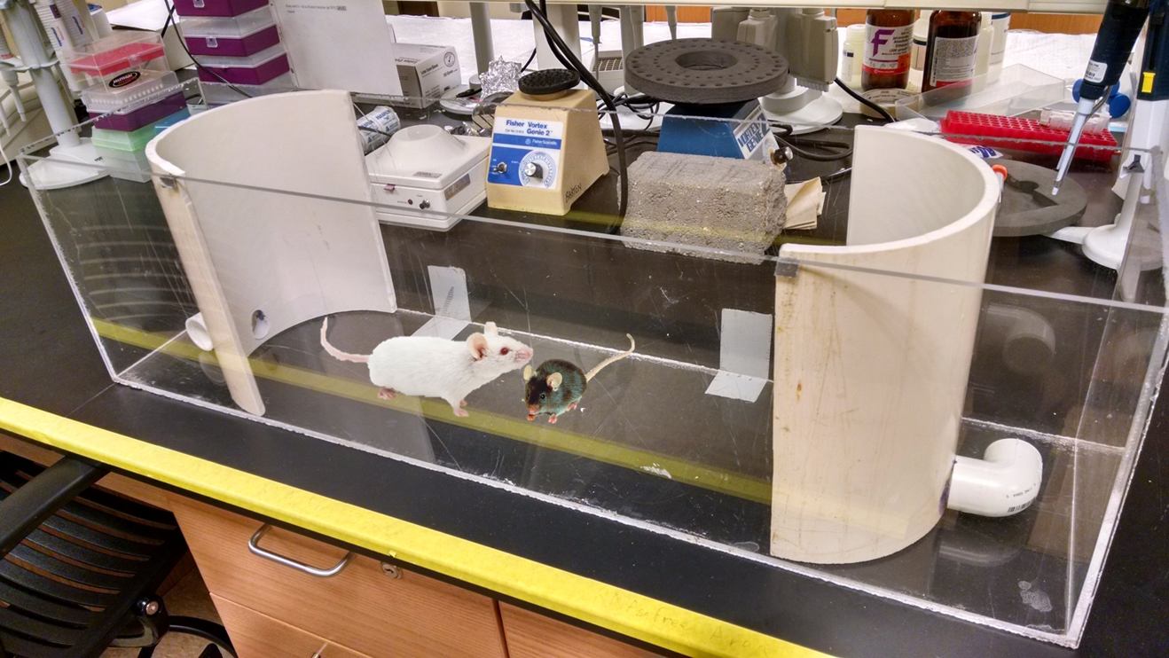
Stress-Alternatives Model
Social Salience
Escape
Stay
Escape

Slide 21
Choice Conclusions
Decision-Making
Action often indicates Choice
But Decisions are NOT Actions
They are
Commitments to Propositions
We cannot measure commitment
∴ commitment must be inferred
by salient ecological conditions

